Slide 1
Iowa Liquor Sales
Arjang Attar Shoushtari
PhD candidate in Marketing
Old Dominion University, Norfolk, Virginia

Slide 2
Data Description
Iowa Liquor Sales: store level data
B2B context
Time frame: January 1, 2012, to current
Rows: 22 million
Columns: 25
Date
Vendor Number
Store Location
Category Number
Bottle Volume (ml)
State Bottle Cost
State Bottle Retail
Sale (Dollars)
Volume Sold (Gallons)

Slide 3
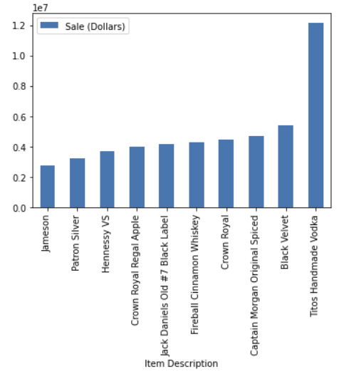
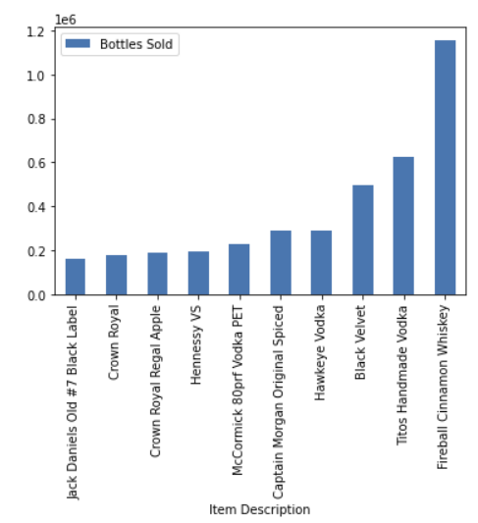
Preliminary Analysis
1879 stores

Slide 4
Future Works
Inventory management
Warehouse optimization
Assortment planning
Combining datasets

Slide 5
Who benefits from the analysis?
Wholesalers
Retailers

Slide 6
Thank you!
Question?

